Slide 1

BRITISH AIRWAYS
Web scraping to gain company insights

Slide 2
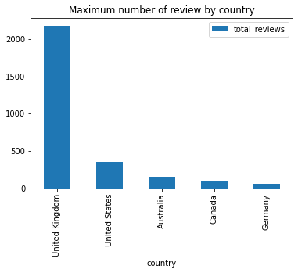
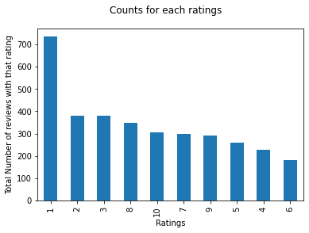
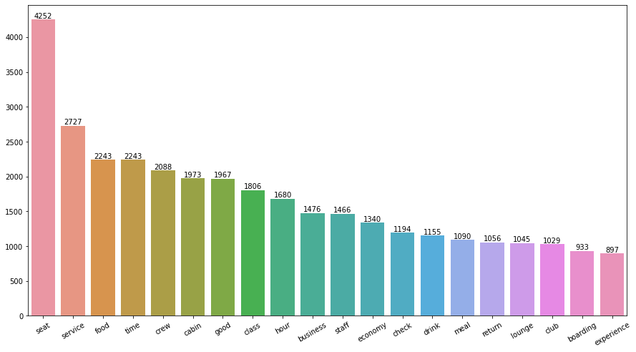
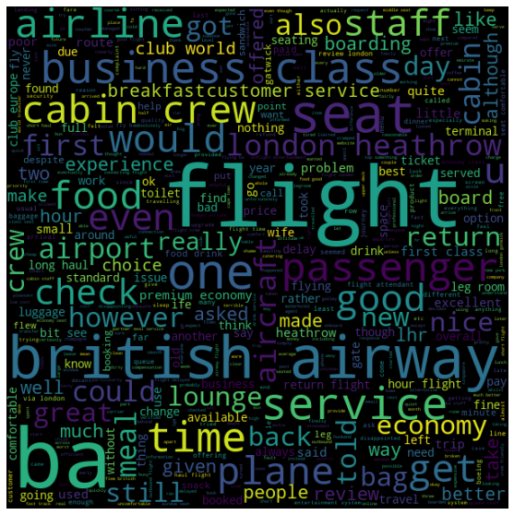
Uncovered Findings:
Total Reviews Collected: 3638
Avg. Rating:
5/10
Reviews from
73 countries:
This gives us a glimpse of what customers are really talking about here. We see that Seat is most talked about the airline followed by "Service" and "food" which are all very important to customers in terms of service.
Customer’s review respective to their rating:
7-10 ratings wrote about comfortable seats, good inflight entertainment, descent food quality.
4-6 ratings faced problem with small entertainment screen, long passport check queue, bad business class experience.
1-3 ratings wrote dissatisfaction on congested middle seat and small screen while they liked the seats and the food.

